Slide 1
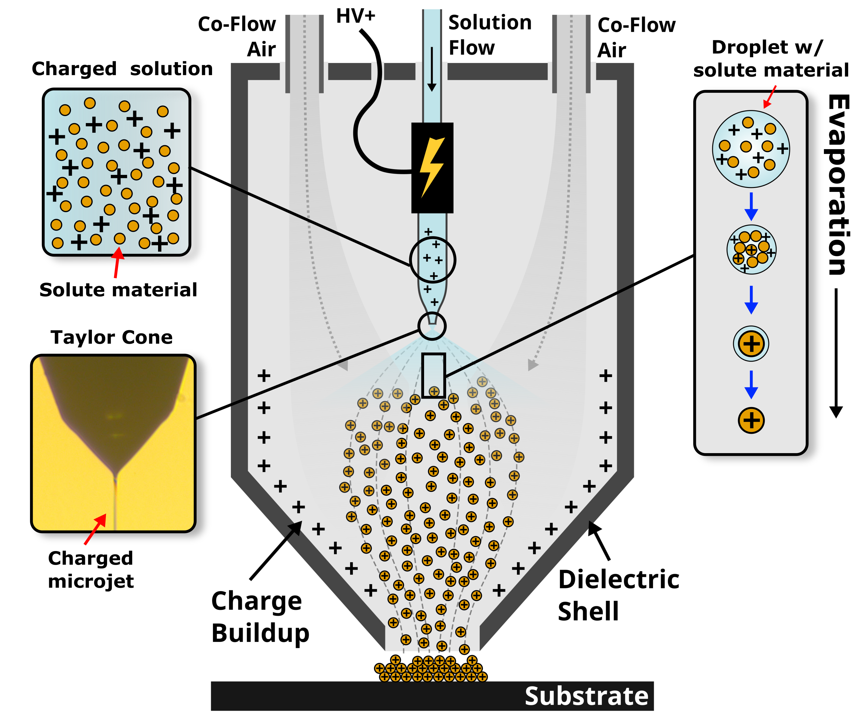
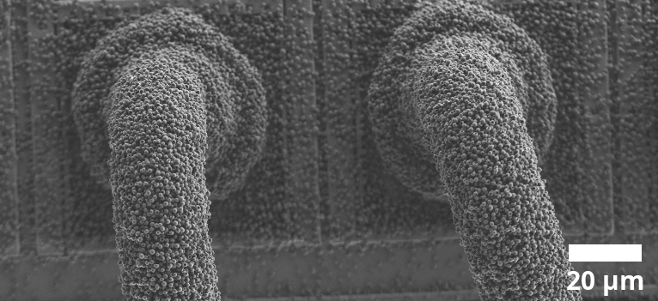
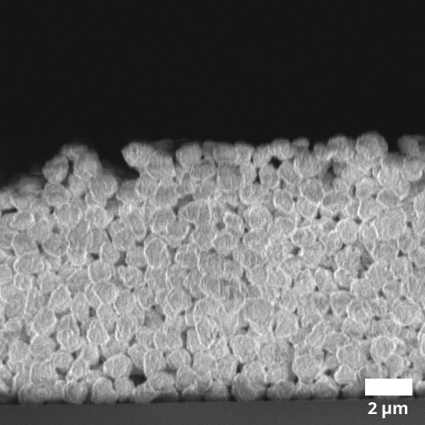
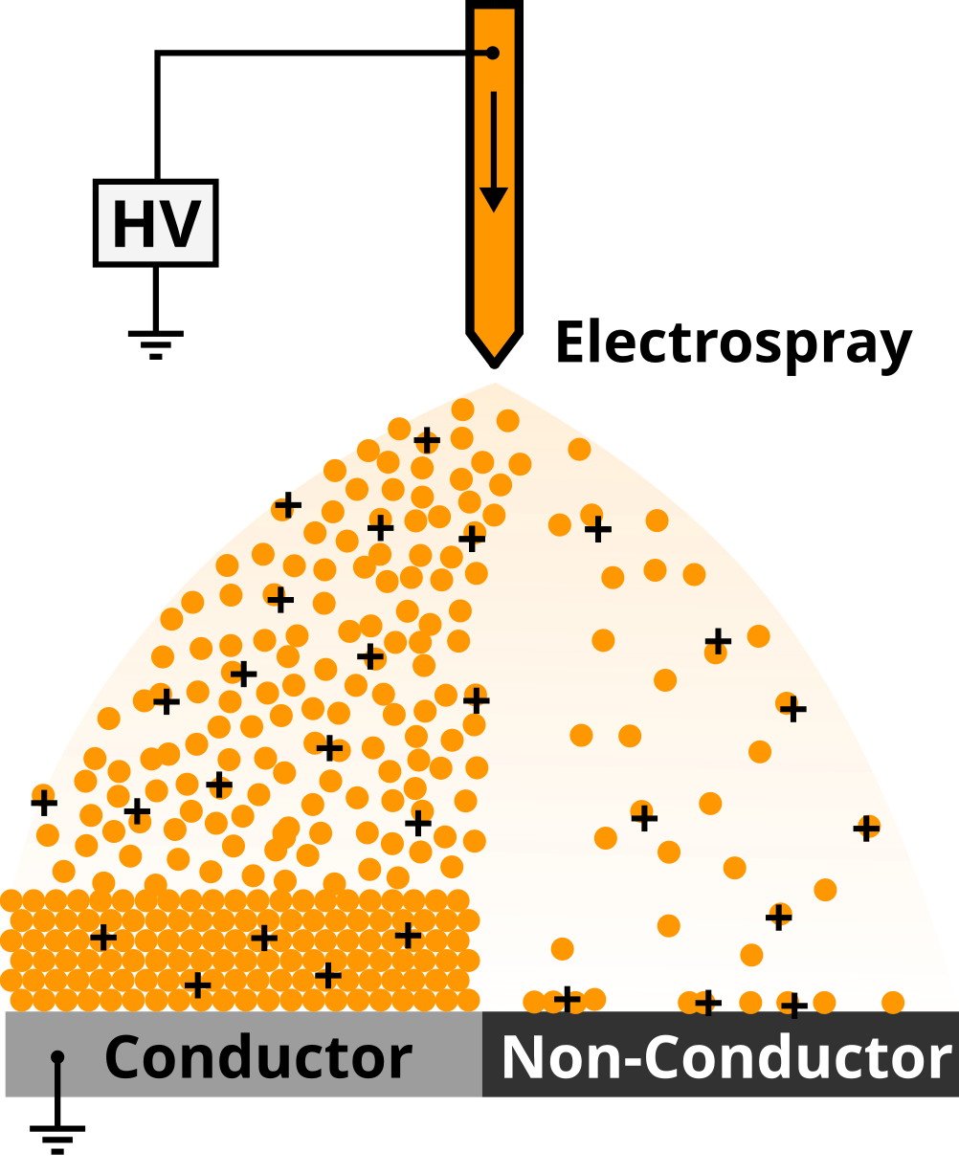
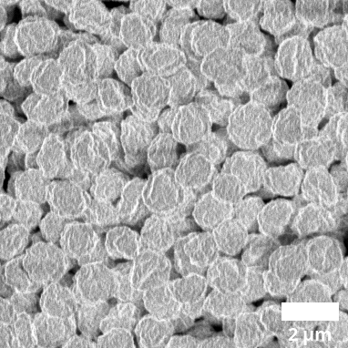
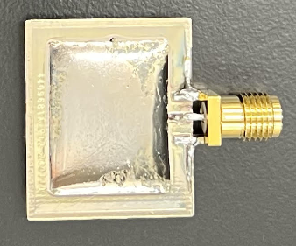
Electrospray Deposition of Thin Films
Prof. Paul Chiarot
Polyimide
Polyimide on wire bonds
Atmospheric processing
Conformal films
Composites
Preferential deposition
In electrospray deposition, a liquid suspension, composed of a solute material in a volatile solvent, is atomized into a plume of electrically charged droplets using a strong electric field. These droplets undergo rapid solvent evaporation, resulting in a spray of particles that are deposited onto a target to create a thin conformal film. Applications: electronics manufacturing and packaging (films providing electrical isolation, corrosion resistance, EMI shielding)
EMI Shielding
Notes:
Images are examples of films created using electrospray deposition.
Top Center, SEM: Polyimide on bond wires (electrical isolation and corrosion resistance)
Top Right, SEM: Polyimide on silicon, side view
Middle Right, SEM: Polyimide on silicon, top view
Bottom Right, Optical: Silver on PCB and epoxy, top view, PCB is a couple centimeters across (EMI Shielding)
“Preferential deposition”: material is preferentially delivered to a region of the target using the local charge “landscape”. For example, insulating material (polymer) will preferentially deposit onto a grounded conductor.

